Slide 1
QUALITY REVOLUTION
Lecture 2

Slide 2
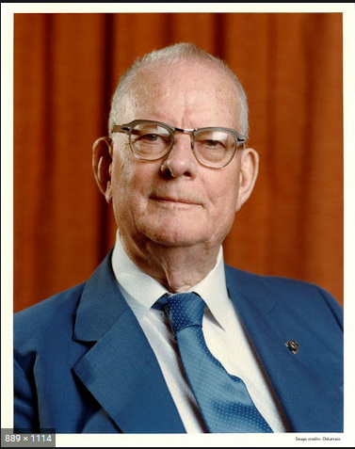
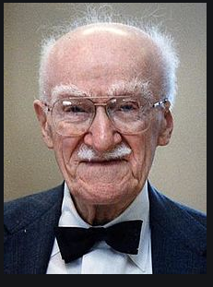
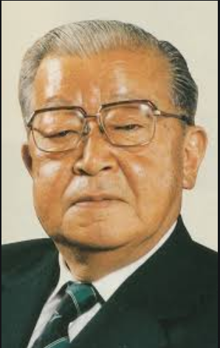
Quality first contributors
A quality movement started in Japan during the 1940s and the 1950s by
William Edwards Deming, Joseph M. Juran, and Kaoru Ishikawa (left to right)
Notes:
Demingg 1951 – teaching
Juran spurred the move from SQC to TQC (total quality control) in Japan

Slide 3
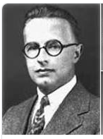
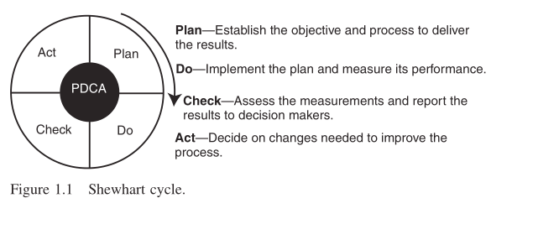
Father of statistical quality control (Shewhart)
This cycle was created by Deming using Sewhart work.

Slide 4
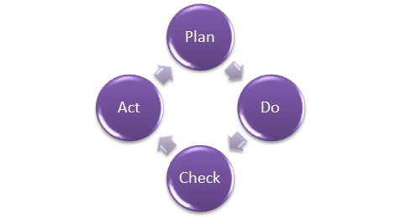
How to do Quality Assurance: Complete Process
Quality assurance has a defined cycle called PDCA cycle or Deming cycle. The phases of this cycle are:
Plan
Do
Check
Act

Slide 5
Quality Assurance Process
These above steps are repeated to ensure that processes followed in the organization are evaluated and improved on a periodic basis. Let's look into the above steps in detail -
Plan - Organization should plan and establish the process related objectives and determine the processes that are required to deliver a high-Quality end product.
Do - Development and testing of Processes and also "do" changes in the processes
Check - Monitoring of processes, modify the processes, and check whether it meets the predetermined objectives
Act - Implement actions that are necessary to achieve improvements in the processes

Slide 6
TQC (Total Quality Control)
By 1968, Kaoru Ishikawa, one of the fathers of TQC in Japan, had outlined, as shown in the following, the key elements of TQC management :
Quality comes first, not short-term profits.
The customer comes first, not the producer.
Decisions are based on facts and data.
Management is participatory and respectful of all employees.
Management is driven by cross-functional committees covering product planning, product design, purchasing, manufacturing, sales, marketing, and distribution.

Slide 7
Cause-and-effect
One of the innovative TQC methodologies developed in Japan is referred
to as the Ishikawa or cause-and-effect diagram.
Kaoru Ishikawa found from statistical data that dispersion in product quality came from four common causes,
namely materials, machines, methods, and measurements, known as the 4 Ms

Slide 8
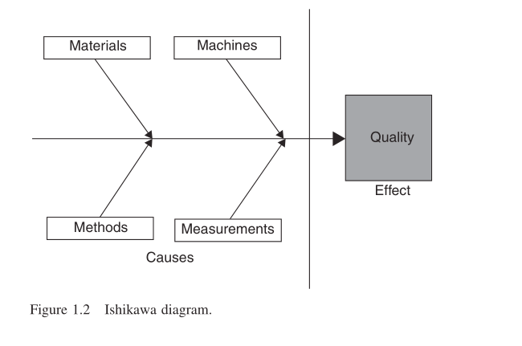
Cause-and-Effect diagram

